Slide 1
Retail Landscape by State
Team 12 : Siwoo Lee, Greg Norman, Andrew Josephson, Krishna Tatineni

Slide 2
Scope
Income/Housing Data
Retail Store Counts by State / zip code
Analysis of relationship between Housing Prices and Retail

Slide 3
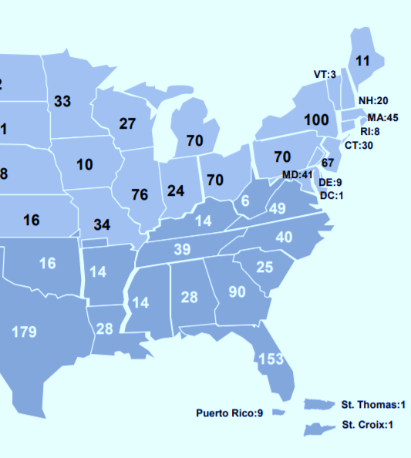
Method
Pull GDP statistics, housing data from Zillow, and store locations from misc. sources such as quarterly earnings releases
Compile data, cleanse, and perform analysis
Derive insights from analysis, including predictive formulas. Connect this data with the real world, and attempt to explain variances

Slide 4
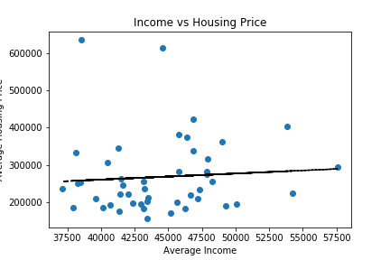


Analysis: Income vs Housing
P-Value | R²
.6345 | .0051
State | Price
Hawaii | $635,176
California | $613,998
Washington | $423,222
Y = 0.000312552893395816(x) + 116.894566800933
X | Projected | Conn. | Maryland | Virginia
$45,000 | $268,541 | $294,637 | $316,660 | $337,822

Slide 5
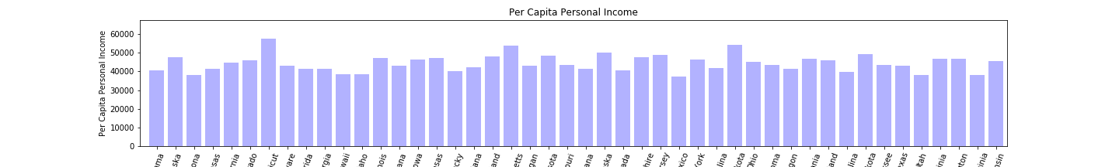
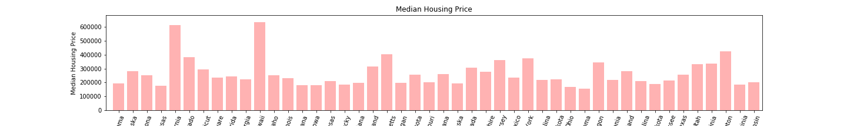

Slide 6
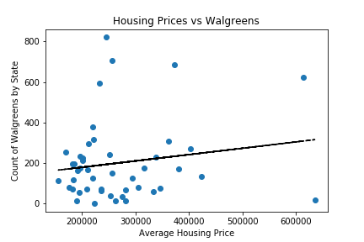

Analysis: Walgreens
P-Value | R²
0.278540955 | 0.02662952
State | Count
Florida | 820
New York | 685
Illinois | 592
Y = 0.000312552893395816(x) + 116.894566800933
X | Projected | Conn. | Maryland | Virginia
$300,000 | 210 | 125 | 174 | 228

Slide 7
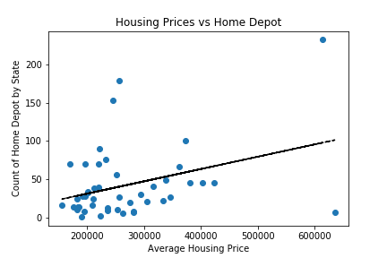

Analysis:
P-Value | R²
0.016309242 | 0.124184856
State | Count
Florida | 153
New York | 100
Georgia | 90
Y = .000160518(x)+-.720548942
X | Projected | Conn. | Maryland | Virginia
$300,000 | 49 | 30 | 41 | 49

Slide 8
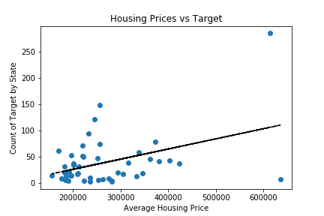

Analysis:
P-Value | R²
0.00540553 | 0.162936
State | Count
Florida | 122
Illinois | 95
New York | 79
Y = 0.00019297787028477(x) + -12.1903806772717
X | Projected | Conn. | Maryland | Virginia
$300,000 | 46 | 20 | 39 | 59

Slide 9
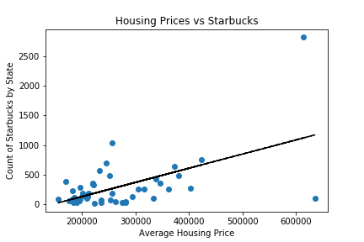

Analysis:
P-Value | R²
0.0000726 | 0.303541886
State | Count
Washington | 757
Florida | 694
New York | 645
Y =.0.00239393943828369(x)+ -348.866840047826
X | Projected | Conn. | Maryland | Virginia
$300,000 | 369 | 123 | 257 | 432

Slide 10
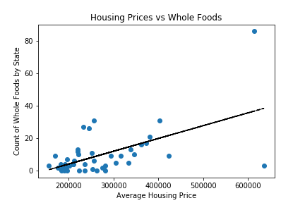

Analysis:
P-Value | R²
0.000038 | 0.322794467
State | Count
Massachusetts | 31
Illinois | 27
Florida | 26
Y = 0.0000789458692947635(x)+-11.6935965242483
X | Projected | Conn. | Maryland | Virginia
$300,000 | 12 | 9 | 9 | 13

Slide 11
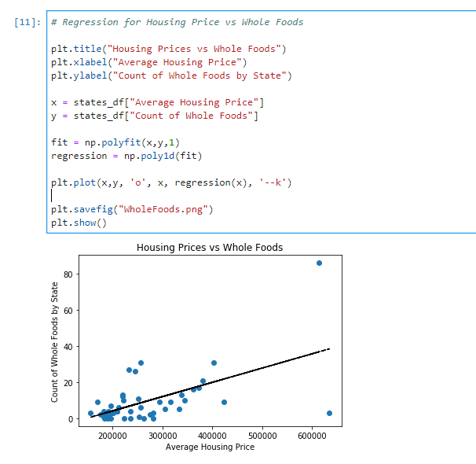
Jupyter Notebook

Slide 12
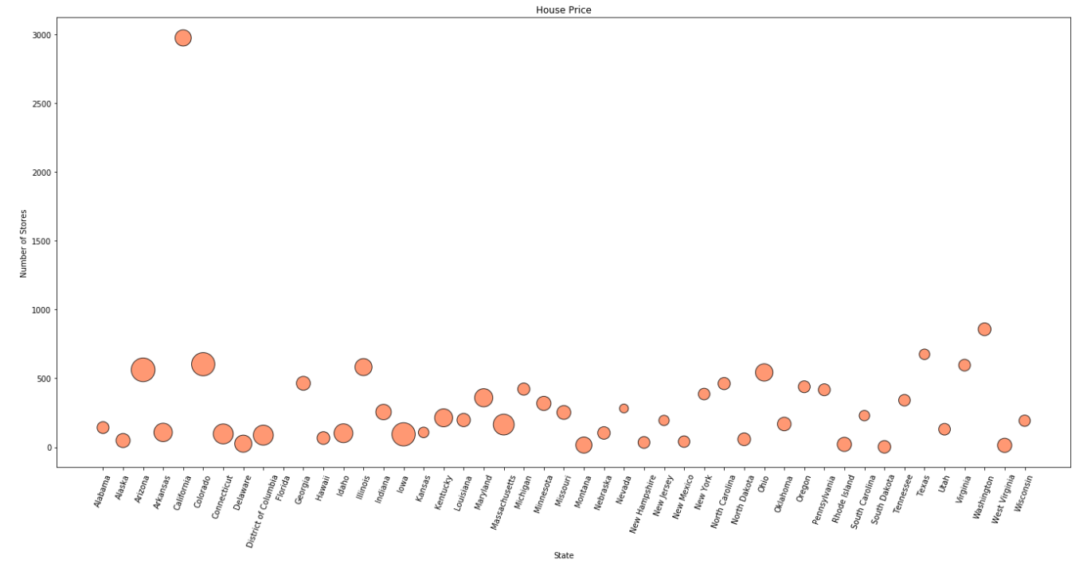
Y axis – Number of stores
X axis – State
Size – Housing Price (Larger the Bubble, higher the price)
Housing Price by State, Store Count

Slide 13
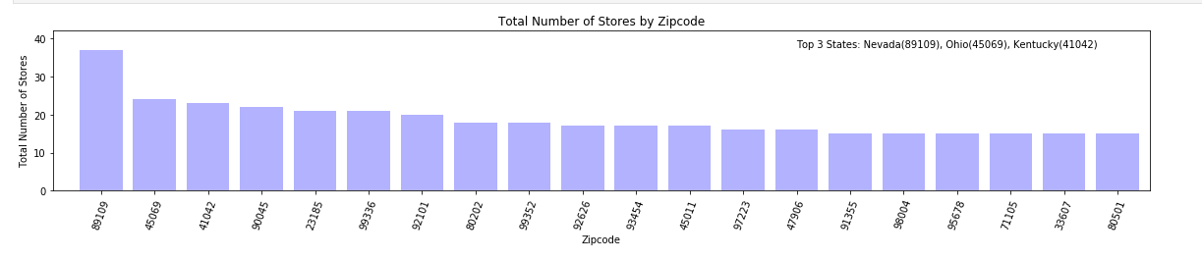
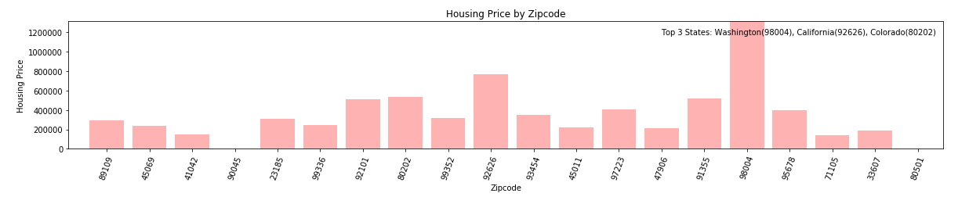

Slide 14
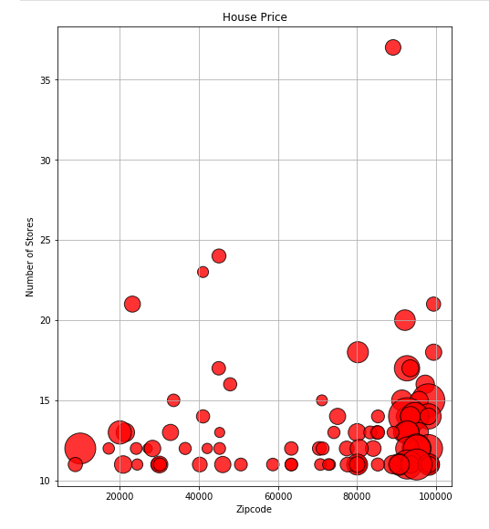
Y axis – Number of Stores
X axis – Zip codes
Size – Housing Price (Larger the Bubble, higher the price)
Housing Price by Zip Code, Store Count

Slide 15
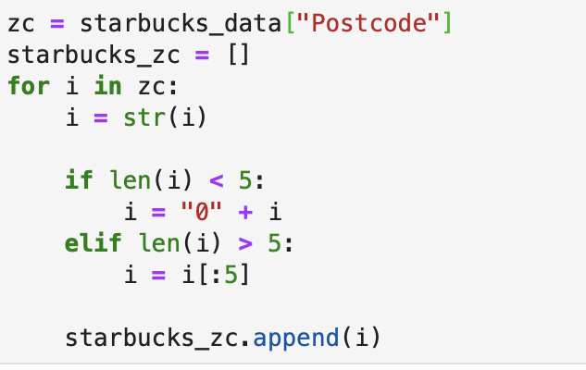
Jupyter Notebook

Slide 16
Outliers
The Boujee-Weighted Index
State | Median Housing Price | Total Store Count | Count Starbucks and Whole Foods | Percentage
California | $613,998 | 4046 | 2907 | 72%
Texas | $255,999 | 2105 | 1073 | 51%
Florida | $245,286 | 1815 | 720 | 40%
New York | $373,425 | 1526 | 662 | 43%
Illinois | $232,493 | 1365 | 602 | 44%
State | Statistic | Total Store Count
North Dakota | $54,213 PCPI (2nd highest) | 20 (lowest)
Hawaii | $635,176 Median Housing Price (highest) | 135 (10th lowest)

Slide 17
Conclusion
No correlation at state level between income and housing price
Low correlation at Zip Code level between housing price and store count. This is potentially due to lack of retail locations in residential areas
Trend starts to be defined by Target and Home Depot locations
Definite trend formed by Starbucks and Whole Foods locations relative to housing price.
Can accurately project count of Whole Foods in a state given median housing price by using regression formula.
Low correlation between housing price and count of Walgreens locations. Target market and business model are more broadly focused

